Slide 2

Movies recommendation system
Vũ Minh Hiếu - 20225485

Slide 3
Content
Introduction
Dataset
Theoretical background and method
Result

Slide 4
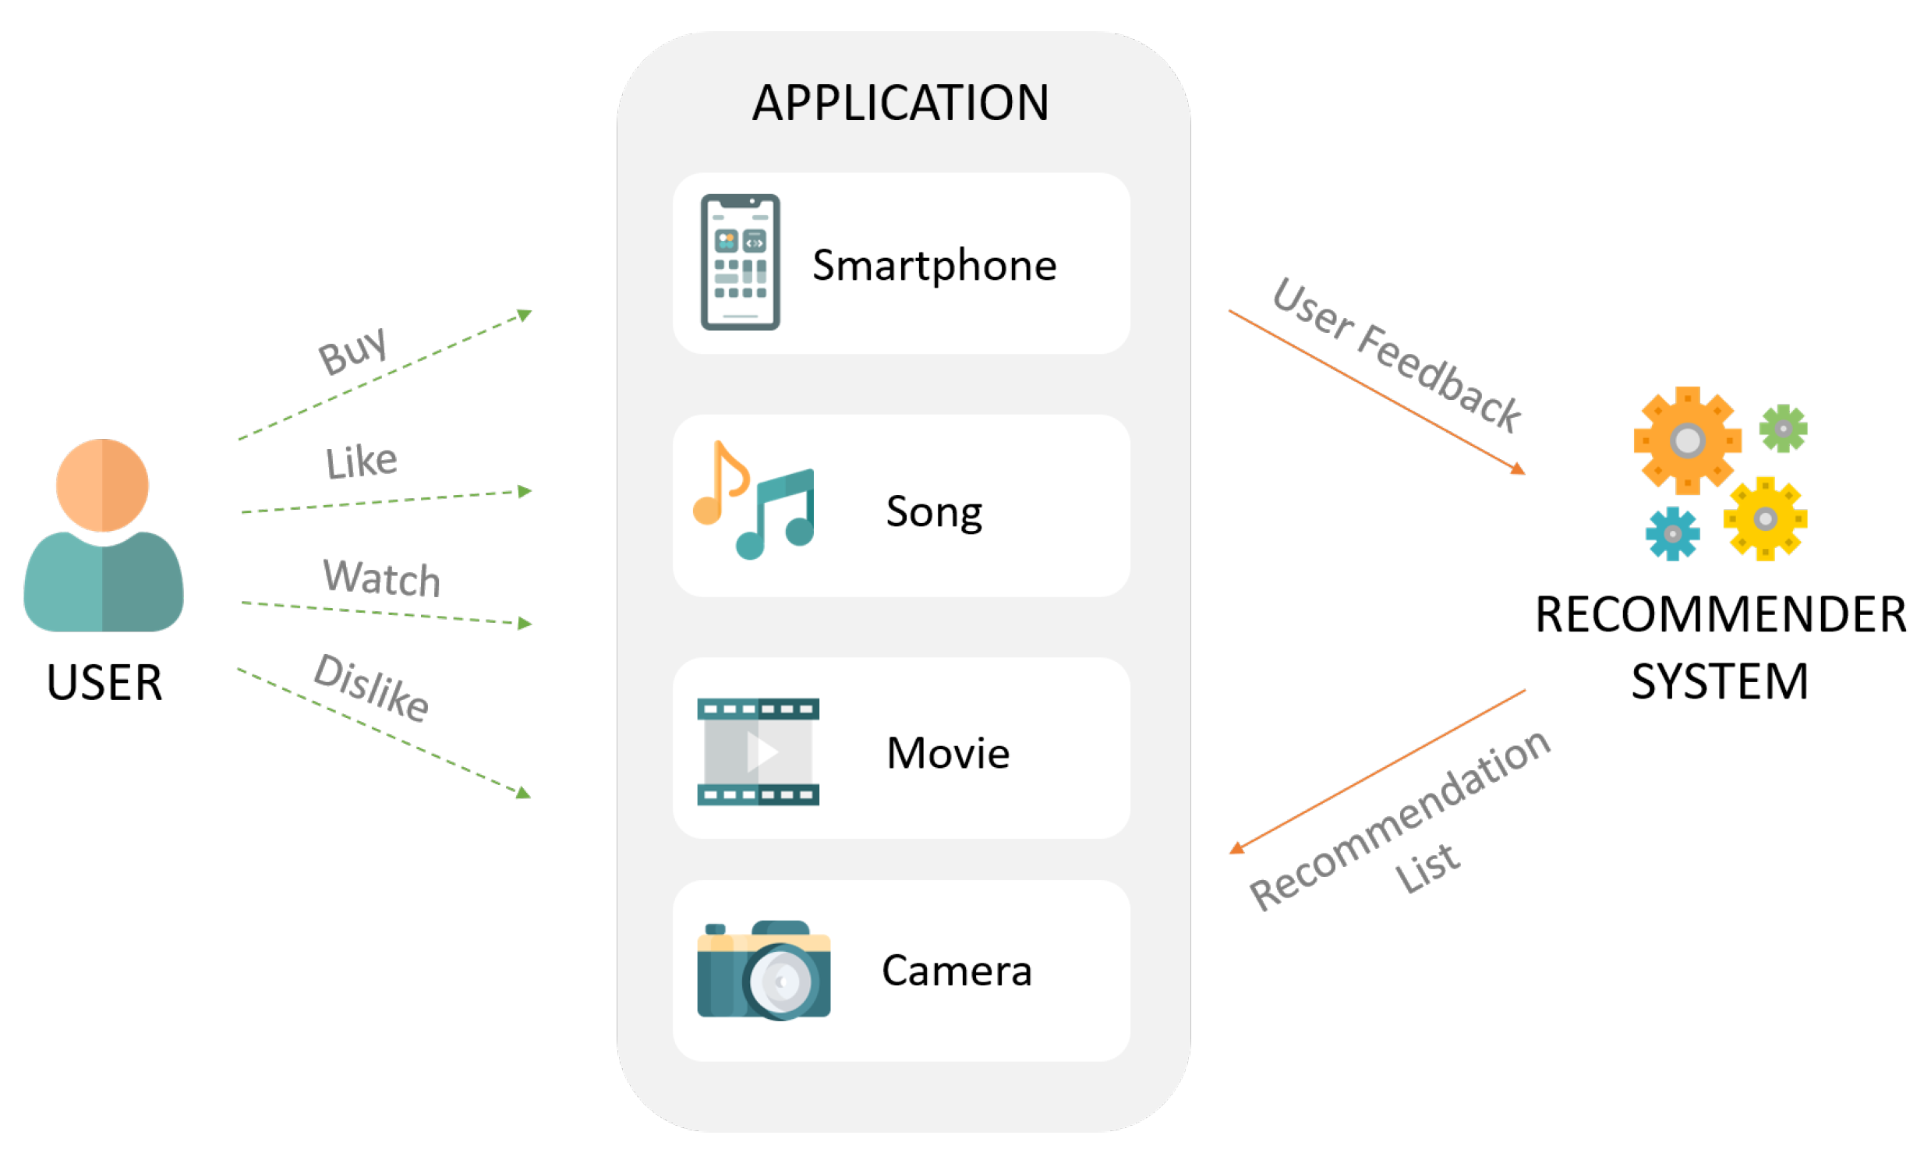
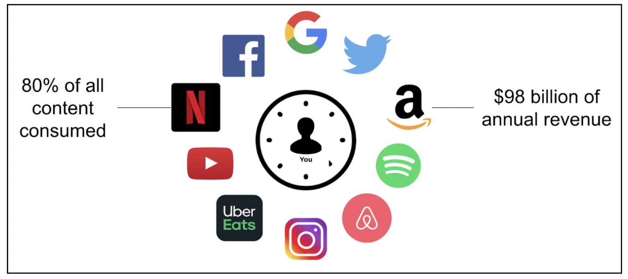
1. Introduction
A class of machine learning that uses data to help predict what people are looking for among a large number of options.
All major business utilize a recommendation system to some extend
This project study and demonstrate some popular recommendation algorithm on a movies data base and discuss theirs advantages, drawbacks and address some further improvement.

Slide 5
2. Dataset
The Movies Dataset
Metadata for all 45,000 movies: cast, crew, plot keywords, revenue, release dates, languages, production companies, TMDB vote counts, vote averages…
26 million ratings from 270,000 users. Ratings are on a scale of 1-5 and have been obtained from the official GroupLens website.

Slide 6
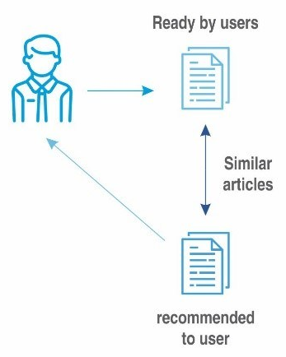
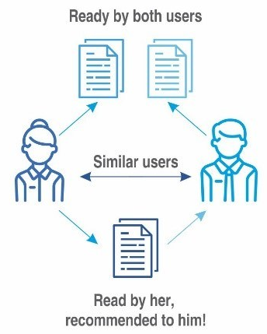
3. Theoretical background and method
Content-Based Filtering
Recommends books based on features (genre, author, description)
Example: If a user likes “Iron-man 1," they might get recommendations for “Iron-man 2"
Collaborative Filtering
Based on user behavior and preferences of similar users
Example: People who liked The Matrix also watch John Wick

Slide 7
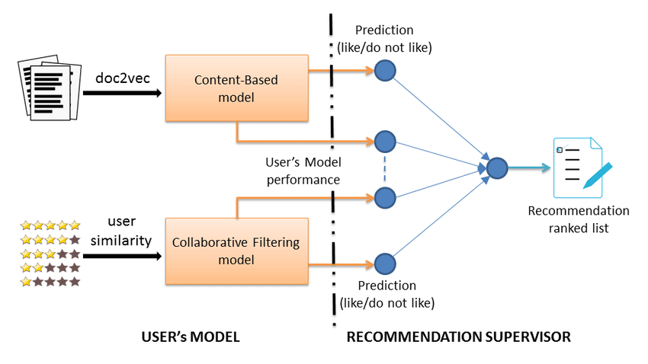
3. Theoretical background and method
Hybrid recommender
collaborative filtering: lack information about the domain dependencies
content-based system: lack information about the people’s preferences in.
=> Combine both methods to get better result.

Slide 8
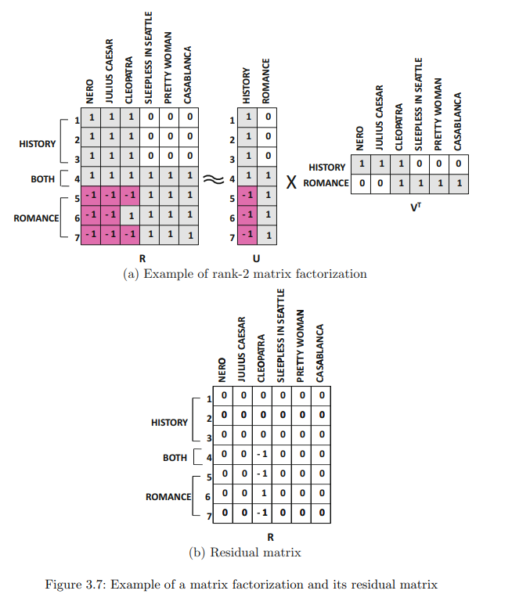
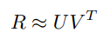
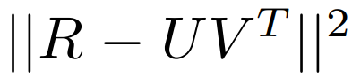
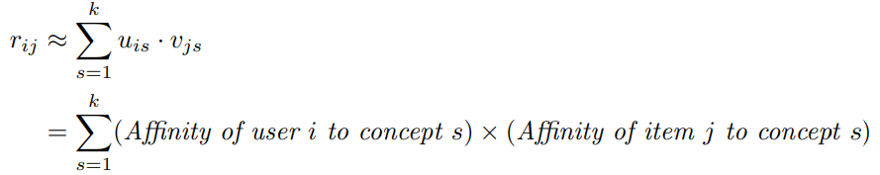
3.1. Collaborative Filtering
Latent factor model
Matrix Factorization: the m x n ratings R with rank y matrix is approximately factorized into an m x k matrix U and an n x k matrix V, where k < y:
The error of this approximation is equal to:
The i-th row u_{i} of U: user factor, contains k entries corresponding to the affinity of user i towards the k concepts in the ratings matrix.
The i-th row v_{i} of V: item factor, represents the affinity of the i-th item towards these k concepts.

Slide 9
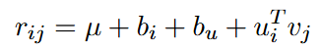
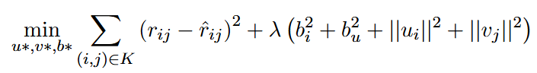
3.1. Collaborative Filtering
Matrix Factorization Algorithm
Many matrix factorization methods exist, the key differences is
the constraints imposed on U and V (e.g., orthogonality or non-negativity)
The nature of the objective function (e.g., minimizing the Frobenius norm or maximizing the likelihood estimation).
Unconstrained Matrix Factorization with bias:
Construct user-item matrix from the data
Model the rating as:
Random initialize the U and V matrix
Minimize the loss function over the set of known ratings:

Slide 10
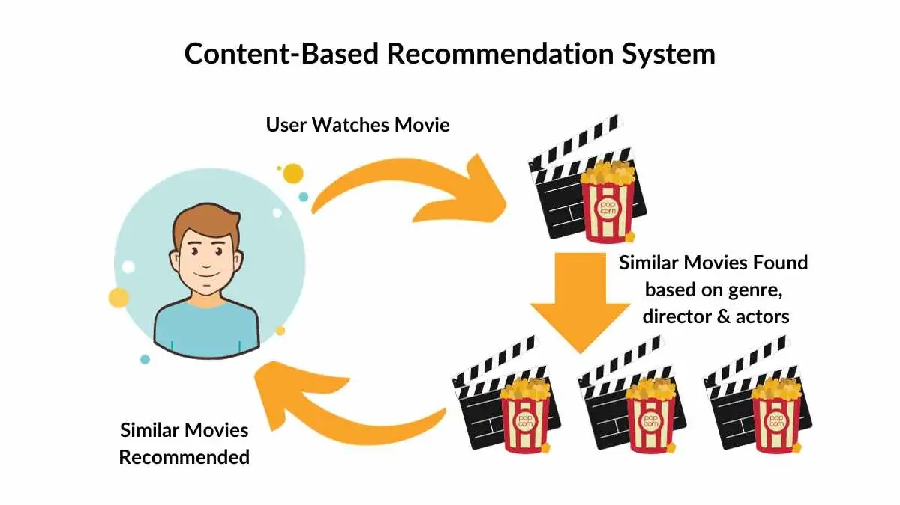
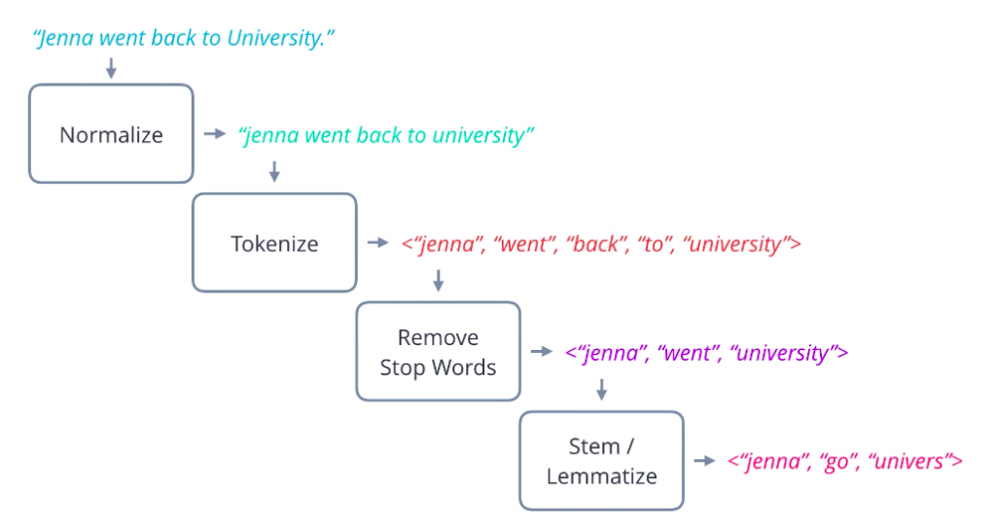
3.2. Content-Based Filtering
Basic component of Content-Based Systems:
Preprocessing and feature extraction
Content-based learning of user profiles
Filtering and recommendation
Features are extracted from various sources (description, tags, ...) and converted to a keyword-based vector-space representation
Cleaning methods:
Stop-word removal
Stemming
Phrase extraction

Slide 11
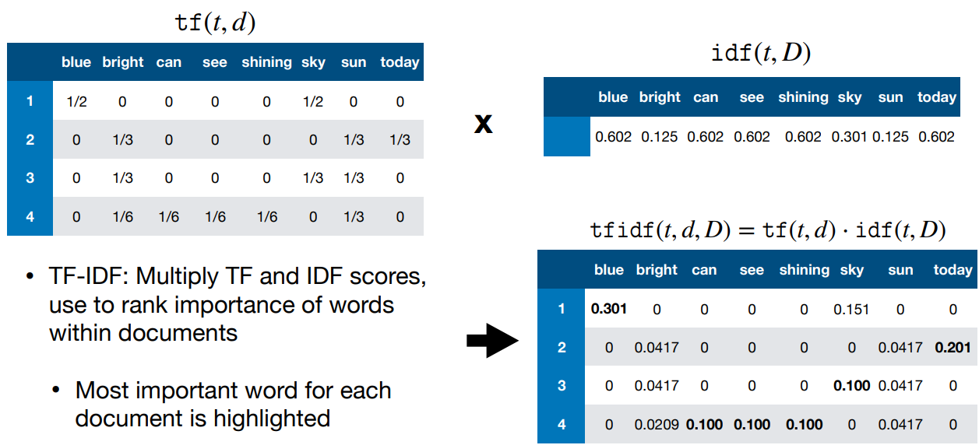
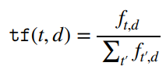
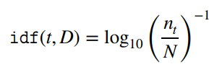
3.2. Content-Based Filtering
Tf-idf matrix
TF-IDF vector

Slide 20
THANK YOU !

